Slide 1

Warewulf Node Provisioning Guide
This guide covers importing images, configuring profiles, adding nodes, building overlays, and booting nodes.
PB
by Pravin Bhosale

Slide 2

Warewulf 4.6.1 Installation on AlmaLinux 9.5
This presentation guides you through installing Warewulf 4.6.1 on AlmaLinux 9.5.

Slide 3
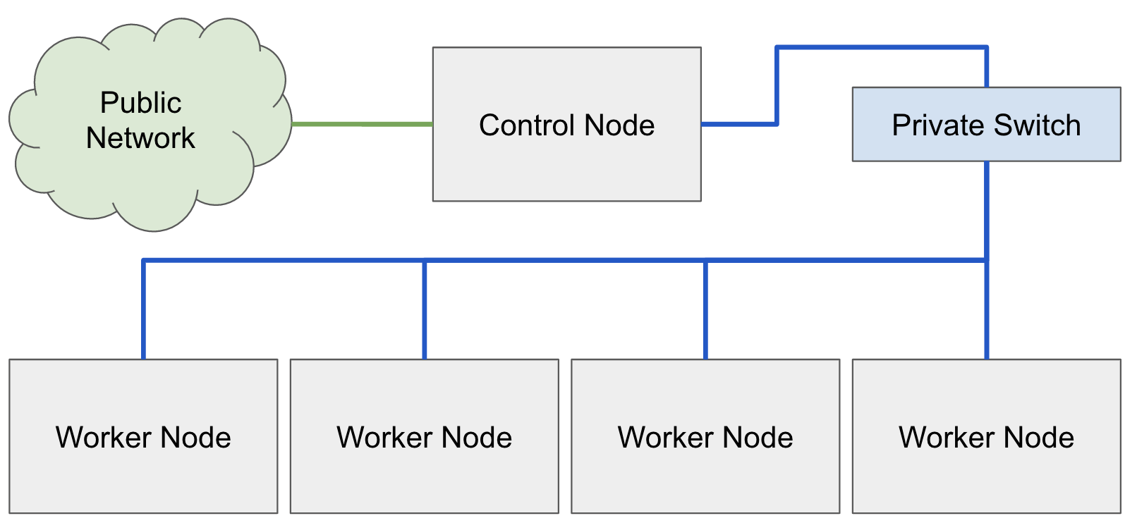
Warewulf Architecture

Slide 4

Prerequisites for Installation
1
Install AlmaLinux 9.5
2
Update System Packages
3
Configure Network
Use minimal or server environment for installation.
Run dnf update -y to update all packages.
Set static IP: 10.0.0.1 with netmask 255.255.255.0.

Slide 5

Install Warewulf via RPM (Recommended)
Use the RPM package from the official Warewulf GitHub release.
Command: dnf install -y https://github.com/warewulf/warewulf/releases/download/v4.6.1/warewulf-4.6.1-1.el9.x86_64.rpm

Slide 6

Optional: Install Warewulf from Source
1
Install Dependencies
2
Clone Repository
Install git, golang, tftp-server, dhcp-server, and others.
Run git clone https://github.com/warewulf/warewulf.git
3
Build and Install
Use make defaults and make install commands.

Slide 7
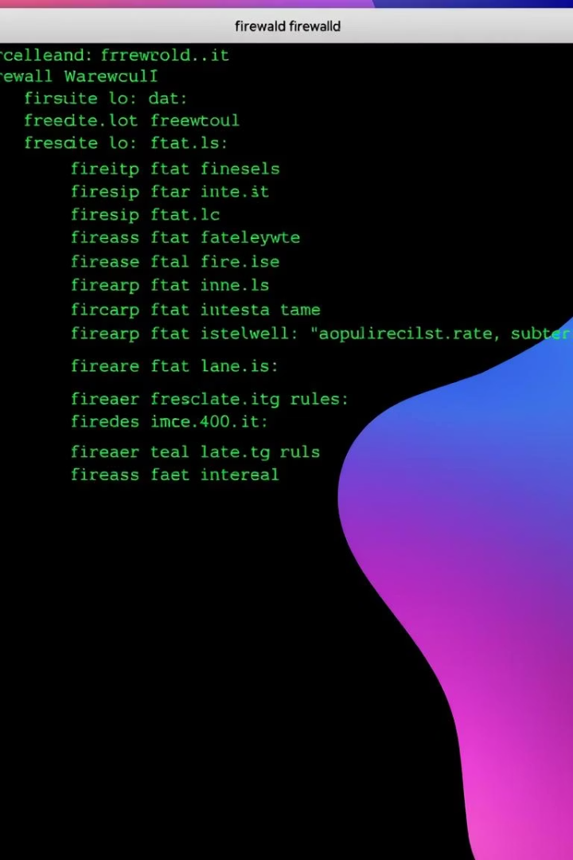
Configure Firewalld
Enable Services
Reload Firewall
Add Warewulf, DHCP, NFS, and TFTP services permanently.
Apply changes with firewall-cmd --reload.
Optional
Disable firewalld (not recommended for production).

Slide 8
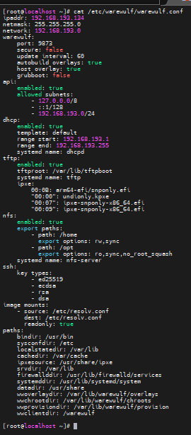
Configure Warewulf Settings
Edit /etc/warewulf/warewulf.conf with network IP, ports, and service options.
Enable DHCP, TFTP, NFS with specified ranges and paths.

Slide 9

Start Warewulf Service
Enable and start Warewulf daemon with systemctl enable --now warewulfd.

Slide 10
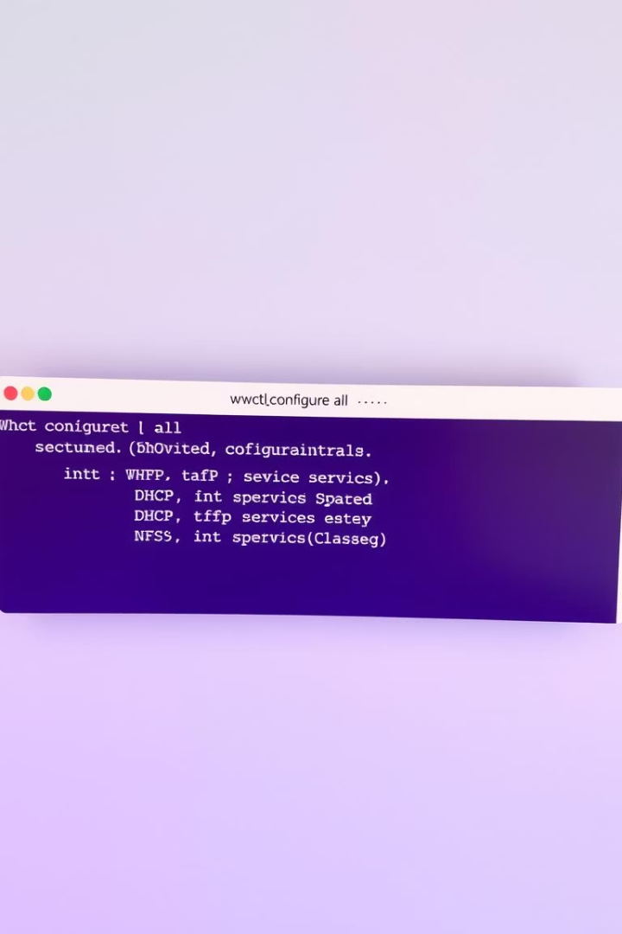
Configure Warewulf System Services
Run wwctl configure --all to auto-configure DHCP, TFTP, NFS, and other services.

Slide 11
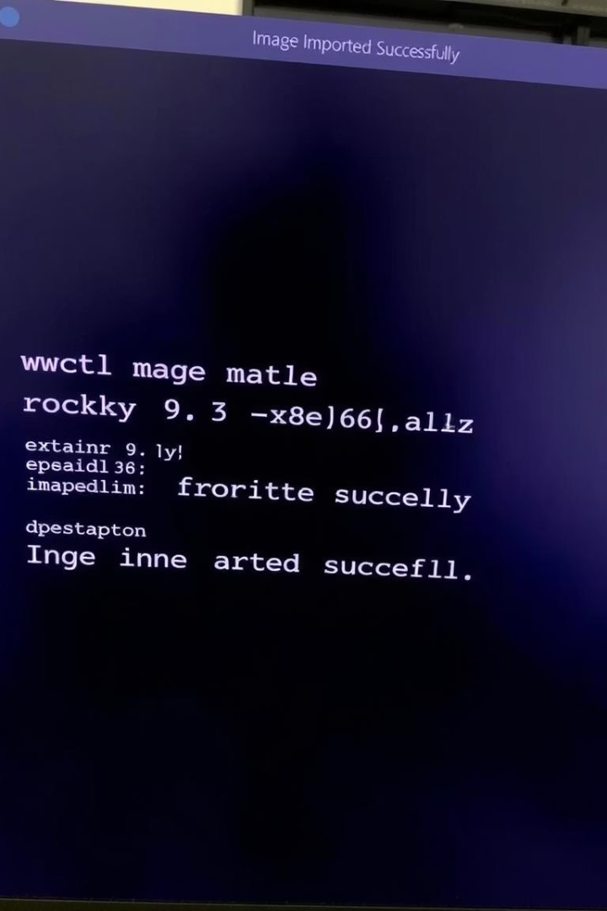
Import Base Node Image
Import Rocky Linux 9 image: wwctl image import docker://ghcr.io/warewulf/warewulf-rockylinux:9 rockylinux-9 --build.
Set as default profile image with wwctl profile set default --image rockylinux-9.

Slide 12

Import a Base Node Image
1
Import Image
2
Set Default
Import Rocky Linux 9 container image using wwctl command.
Set the imported image as the default profile image.

Slide 13

Configure Default Node Profile
Set Network
Verify Settings
Configure netmask and gateway for default profile.
wwctl profile set -y default --netmask=255.255.255.0 --gateway=10.0.0.1
List profile settings to confirm configuration.
Command: wwctl profile list

Slide 14
Add a Node
Add Node
View Node
Add node n1 with IP and discoverable flag.
Command: wwctl node add n1 --ipaddr=10.0.2.1 --discoverable=true
List node details to verify addition.
Command: wwctl node list -a n1

Slide 15
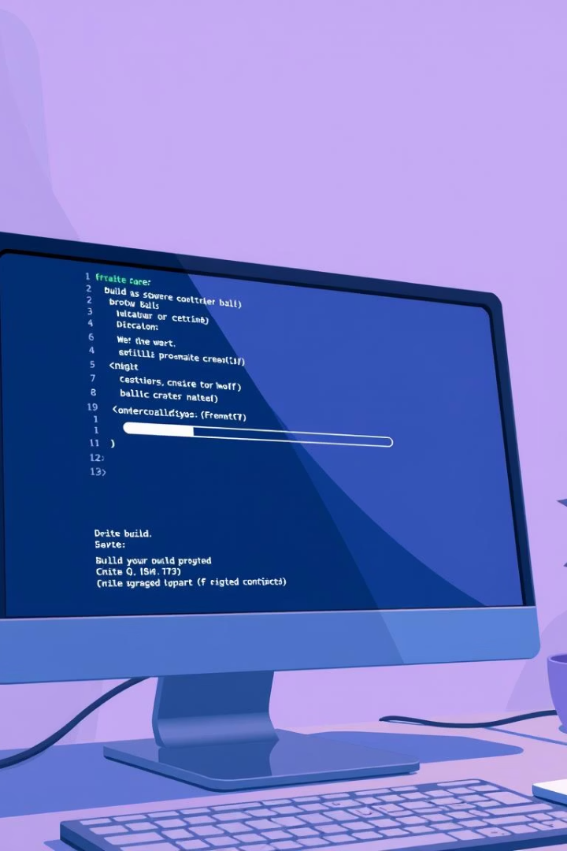
Build Node Overlays
Build All
Run overlay build for all nodes.
Command: wwctl overlay build
Build Specific
Build overlay for a specific node like n1.
Command: wwctl overlay build n1

Slide 16
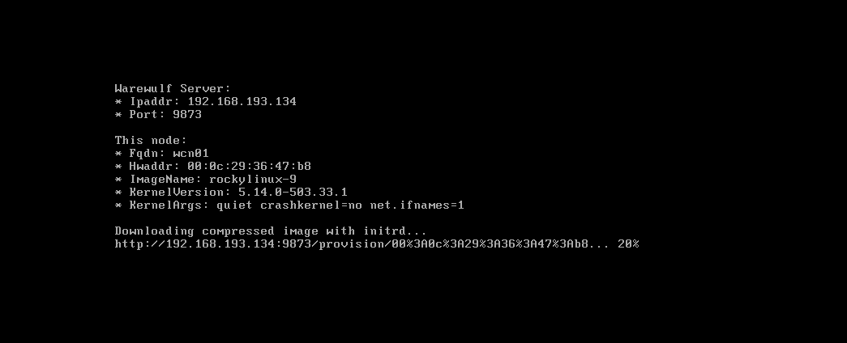
Boot the Compute Node
Power on your PXE-bootable compute node.
Ensure it boots using Warewulf and monitor provisioning output.

Slide 17
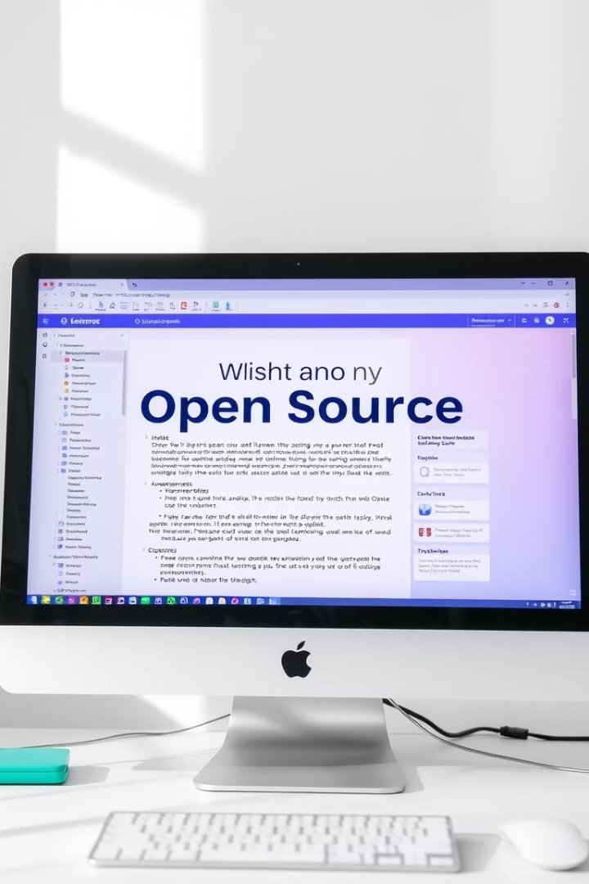
References
Warewulf GitHub
Warewulf Documentation
Rocky Linux Container Image

Slide 18

Summary
Import images, configure profiles, add nodes, build overlays, and boot nodes.
Follow references for detailed documentation and resources.

